Slide 1

Array based Stacks Linked Stacks
Data Structure | ADT: Stack and Queue
Course: Data Structure | Chapter: ADT: Stack and Queue | Program: Bachelor of Engineering
DISCOVER · LEARN · EMPOWER
Notes:
Welcome everyone to today's session on Data Structures. We are focusing on the fundamental Abstract Data Types of Stacks and Queues. Specifically, we will dive deep into how we implement stacks using arrays versus linked lists. Remember, Chandigarh University's motto is Discover. Learn. Empower, and today you will discover two critical implementation strategies.

Slide 2
Course Outcomes
SLIDE 2 / 10
Course Outcome
CO | BT LEVEL | DESCRIPTION
CO1 | BT1 | Understand and apply basic data structures, algorithms, complexity analysis, ADTs, arrays and linked lists.
CO2 | BT2 | Apply and implement stacks and queues in problem-solving.
CO3 | BT3 | Analyse and apply searching, sorting, and hashing techniques.
CO4 | BT4 | Construct and apply tree structures and traversal techniques.
CO5 | BT5 | Represent and solve graph problems using DFS, BFS, and graph algorithms.
Chandigarh University
2 / 10
Notes:
Today's lecture directly supports our Course Outcomes. While we focus on stacks, the analytical skills you develop here are essential for CO3 regarding searching and sorting techniques. Furthermore, understanding these linear structures is a prerequisite for constructing complex tree structures mentioned in CO4. Mastering these basics ensures you can apply traversal techniques effectively later.

Slide 3
Learning Objectives
SLIDE 3 / 10
Learning Outcomes
1
Define the Abstract Data Type of a Stack and its core operations.
2
Analyze the implementation of stacks using fixed-size arrays.
3
Evaluate the implementation of stacks using dynamic linked lists.
4
Compare the time and space complexities of both approaches.
5
Apply stack operations to solve real-world memory management problems.
Chandigarh University
3 / 10
Notes:
By the end of this lecture, you will be able to define a stack and distinguish between its two main implementations. You will analyze how arrays handle memory statically while linked lists handle it dynamically. We will evaluate the trade-offs in time and space complexity for push and pop operations. Finally, you will apply these concepts to solve practical memory management problems.

Slide 4

Lecture
SLIDE 4 / 10
Stack ADT Definition and Operations
1
A Stack is a linear data structure following the Last-In-First-Out principle.
2
The top element is the only one accessible for insertion or deletion.
3
Push operation adds an element to the top of the stack.
4
Pop operation removes the most recently added element from the stack.
5
Peek operation retrieves the top element without removing it from the stack.
Tectonic Plates boundaries - main boundary types
Chandigarh University
4 / 10
Notes:
Think of a stack like a stack of plates in a cafeteria; you can only add or remove the top plate. The Last-In-First-Out principle means the last item added is the first one removed. Push adds an item to the top, while pop removes the top item. The peek operation lets you see the top item without disturbing the stack structure.

Slide 5
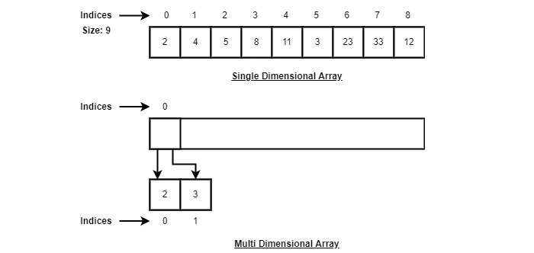
Lecture
SLIDE 5 / 10
Array Based Stack Implementation
1
An array based stack uses a fixed-size contiguous block of memory.
2
A variable 'top' tracks the index of the current top element.
3
Push operation increments 'top' and stores the new element at that index.
4
Pop operation retrieves the element at 'top' and decrements the index.
5
Stack overflow occurs if 'top' reaches the maximum array size limit.
Source: www.tutorialspoint.com
Chandigarh University
5 / 10
Notes:
In an array based stack, we allocate a fixed amount of memory at the start. We use a variable called 'top' to keep track of the current position. When you push an item, we increment 'top' and store the value. If 'top' reaches the maximum size, we get a stack overflow error, which is a key limitation of this approach.

Slide 6
Lecture
SLIDE 6 / 10
Linked Stack Implementation
1
A linked stack uses nodes connected by pointers to form a chain.
2
Each node contains data and a pointer to the next node in the chain.
3
The 'head' pointer always points to the top element of the stack.
4
Push operation creates a new node and links it to the current head.
5
Pop operation removes the head node and updates the head pointer.
Chandigarh University
6 / 10
Notes:
Unlike arrays, a linked stack does not have a fixed size limit. Each element is a node containing data and a pointer to the next node. The head pointer always points to the top of the stack. When you push, you create a new node and make it the new head. When you pop, you simply move the head pointer to the next node.

Slide 7
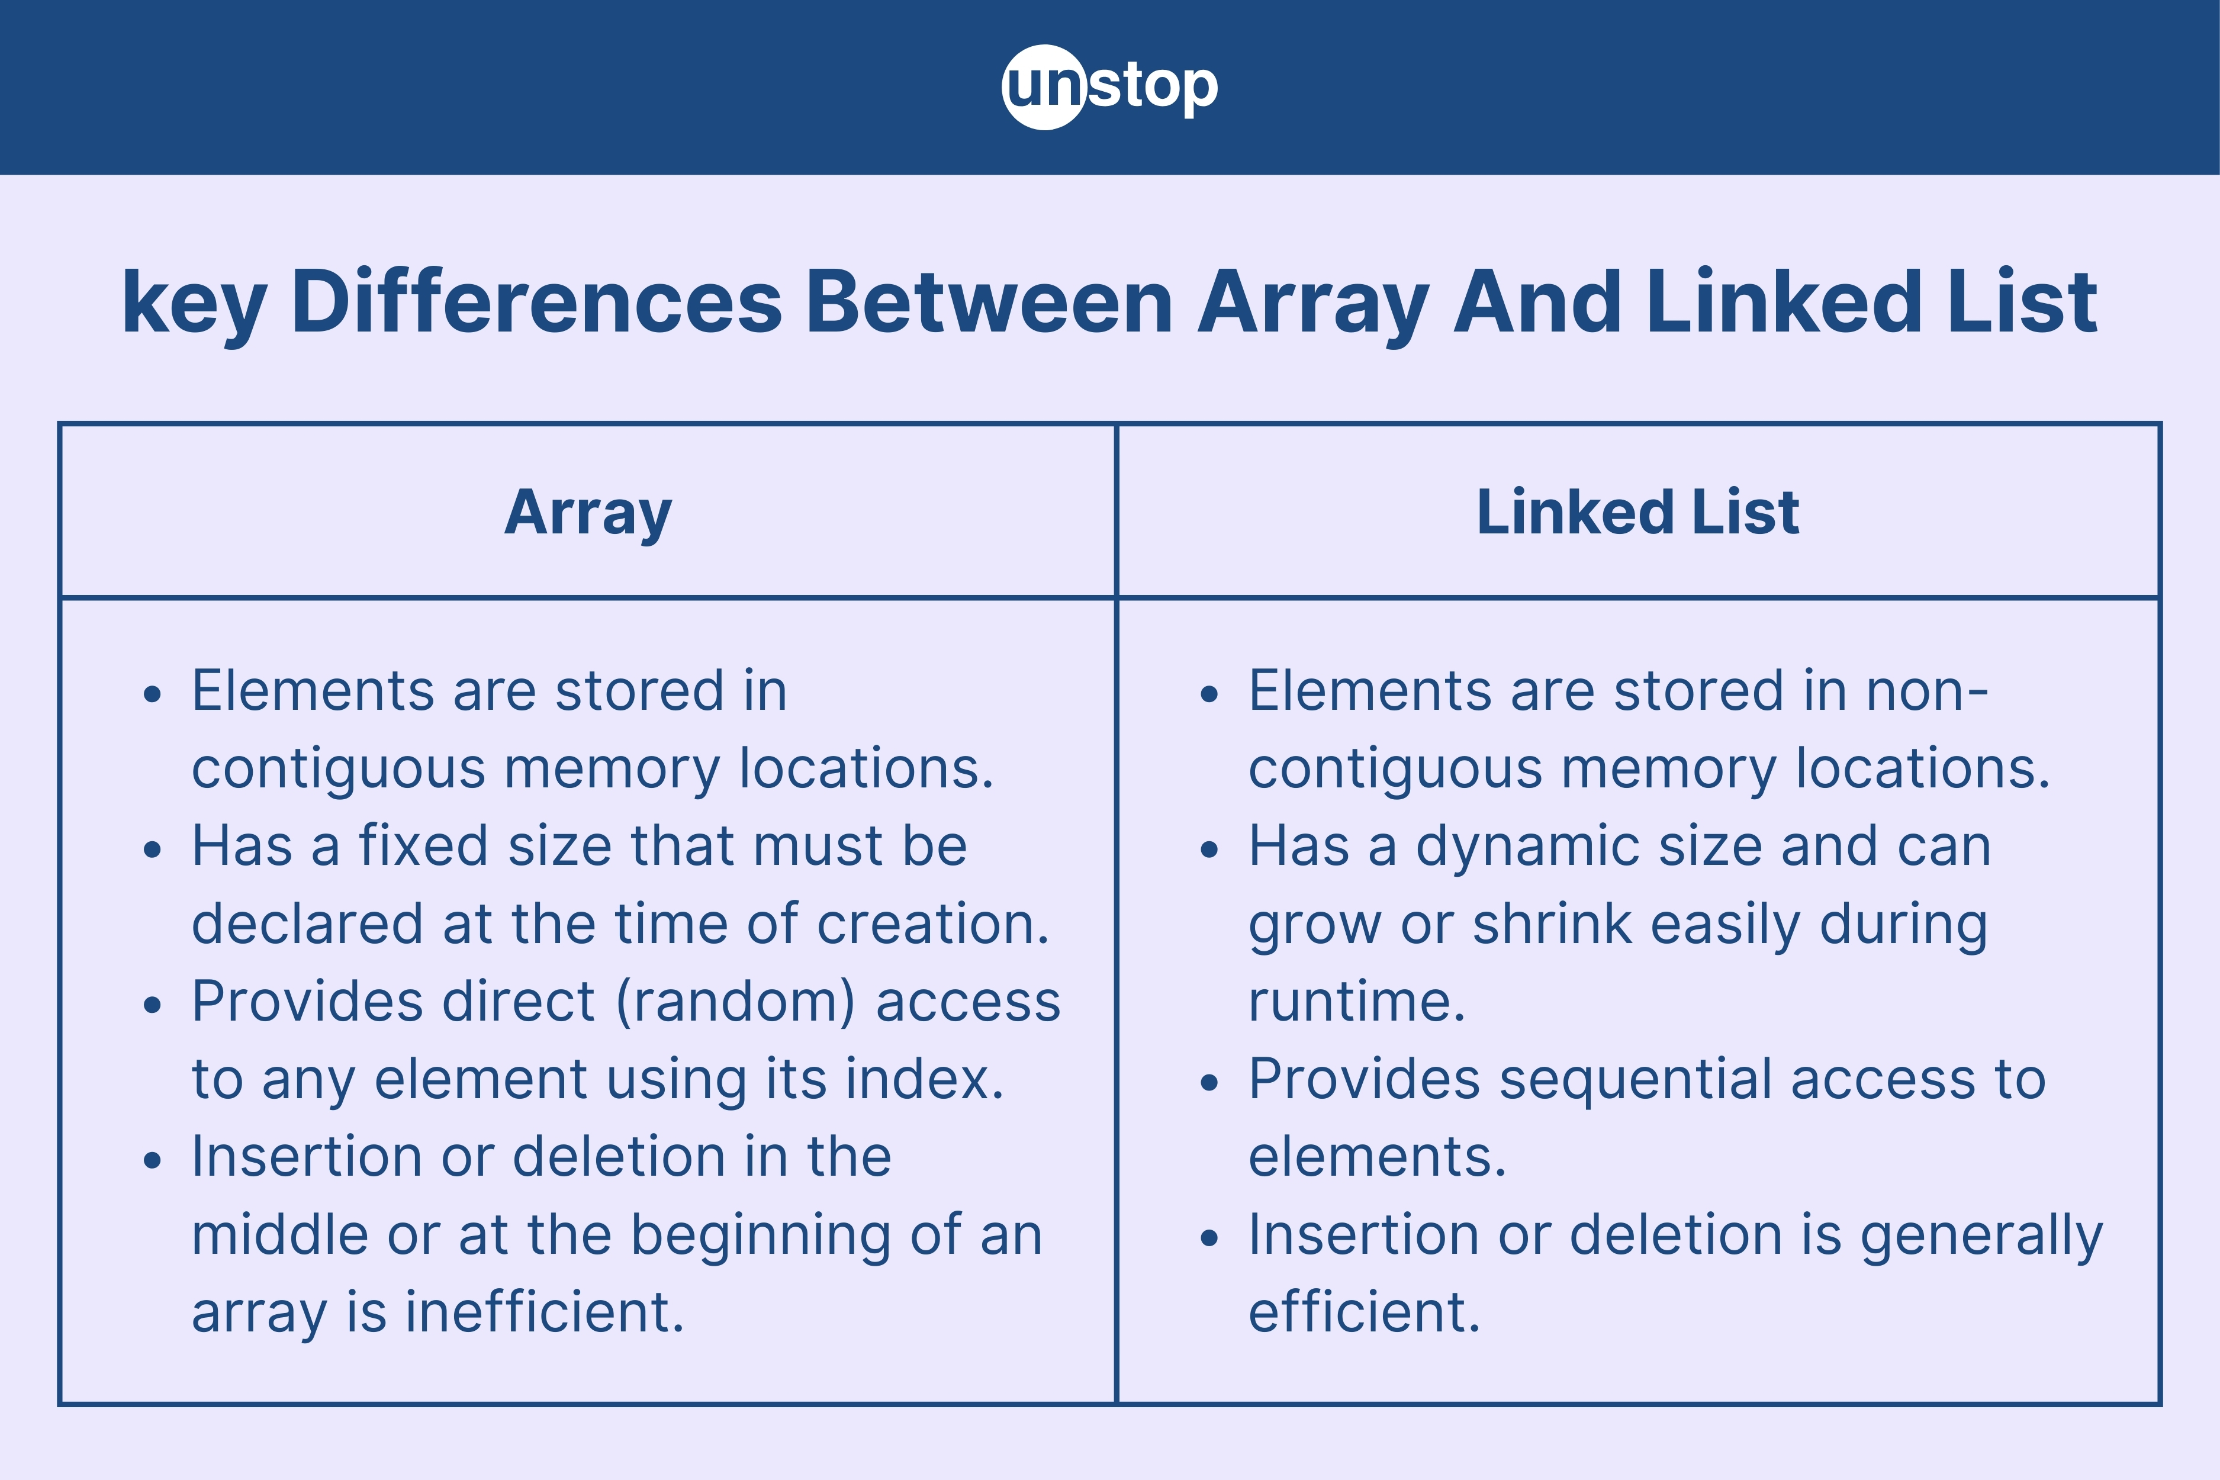
Comparison
SLIDE 7 / 10
Array vs Linked Stack
1
Arrays offer faster access time due to contiguous memory allocation.
2
Linked lists provide dynamic memory allocation without fixed size limits.
3
Arrays waste memory if the stack size is smaller than allocated capacity.
4
Linked lists incur overhead for storing pointers in each node.
5
Arrays are simpler to implement but risk overflow errors easily.
Source: d8it4huxumps7.cloudfront.net
Chandigarh University
7 / 10
Notes:
Arrays are faster for access because the memory is contiguous, but they waste space if not fully utilized. Linked lists are more flexible as they grow dynamically, but they use extra memory for pointers. Arrays are simpler to code but can crash with overflow errors. Linked lists are more robust against overflow but slightly slower due to pointer chasing.

Slide 8
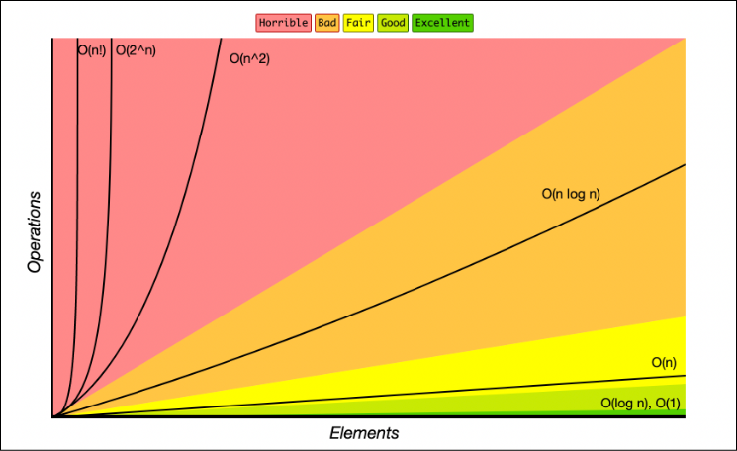
Lecture
SLIDE 8 / 10
Complexity Analysis of Operations
1
Push operation has O(1) time complexity for both array and linked stacks.
2
Pop operation has O(1) time complexity for both array and linked stacks.
3
Peek operation has O(1) time complexity for both array and linked stacks.
4
Space complexity is O(n) for both implementations where n is elements.
5
Array space is fixed O(max_size) while linked space is dynamic O(n).
Source: paper-attachments.dropbox.com
Chandigarh University
8 / 10
Notes:
Both implementations are highly efficient with constant time complexity for all basic operations. Whether you use an array or a linked list, push, pop, and peek take O(1) time. The space complexity is linear, O(n), for the number of elements stored. However, arrays reserve a fixed block, while linked lists allocate memory only as needed.

Slide 9

Lecture
SLIDE 9 / 10
Key Takeaways
1
Stacks follow the Last-In-First-Out principle for data management.
2
Array stacks are fast but limited by fixed maximum size constraints.
3
Linked stacks are flexible but require additional memory for pointers.
4
Both implementations offer O(1) time complexity for core operations.
5
Choice depends on whether fixed size or dynamic growth is required.
Source: www.slideteam.net
Chandigarh University
9 / 10
Notes:
To summarize, stacks are LIFO structures essential for many algorithms. Arrays provide speed but lack flexibility, while linked lists offer dynamic growth at a slight memory cost. Both methods are equally efficient in terms of time complexity for operations. Your choice between them should depend on whether you need a fixed size or dynamic growth.

Slide 10
Lecture
SLIDE 10 / 10
References
DATA STRUCTURES
A Pseudocode Approach with C — Gilberg, Forouzan
• Data Structures — Lipschutz
• Data Structure Using C — AK Sharma
• C and Data structure — P. S. Deshpandey
Chandigarh University
10 / 10
Notes:
For further reading, please refer to the standard textbooks listed on this slide. Gilberg and Forouzan provide excellent pseudocode approaches for understanding logic. Lipschutz and Sharma offer deep insights into C implementations. Deshpandey is also a valuable resource for practical C and data structure applications.

